Slide 1
Computer Networking
Introduction
Chapter 1

Slide 2

Data Communication: Motivation
Efficient way to share resources
Cost – less expensive
Accessibility – easier
Efficient way to exchange information
Time – faster
Size – bigger
Correctness – more accurate

Slide 3
Data Communication: Definition
Delivery
Accuracy
Transfer of data from one device to another via
some form of transmission medium.
Timeliness
Jitter
Notes:
The effectiveness of a data communications system depends on four fundamental characteristics: Delivery, Accuracy, timeliness, Jitter

Slide 4

Data Communication: Definition
Hi,
Hi,
how
how
are
are
you?
you?
Hi, how are you?
Hi, how are you?
Computer
01010001
01010001

Slide 5
Components in Communication
1
Message
Hi, how are you?
5
Protocol
2
Sender
3
Receiver
4
Medium

Slide 6
Data Representation
Numbers
8/16/32 bit integers
floating point
Text
ASCII, Unicode
Images
Bit patterns, Graphics formats JPG/GIF/etc
Audio → Samples of continuous signal
Video → Sequence of bitmap images

Slide 7
Direction of Data Flow
Simplex: One direction only
data flow
Server
Monitor
data flow
Keyboard
Server

Slide 8
Direction of Data Flow
Half Duplex: Both directions, one at a time
E.g., walkie-talkies
data flow at time 1
data flow at time 2

Slide 9

Direction of Data Flow
Full Duplex: Both directions simultaneously
E.g. telephone
The capacity of the channel is divided between the two directions.
data flow
data flow

Slide 10
Networks
Network: a set of devices connected by media links
Laptop
Workstation
Media Links
Server
Printer
Scanner

Slide 11
Networking Impacts in Our Daily Lives
Networks support the way we learn.
Networks support the way we communicate.
Networks support the way we work.
Networks support the way we play.

Slide 12
Network Criteria
Performance
Throughput
Delay
Reliability
Frequency of failure
Time to recover from a failure
Network’s robustness
Security
Unauthorized access

Slide 13
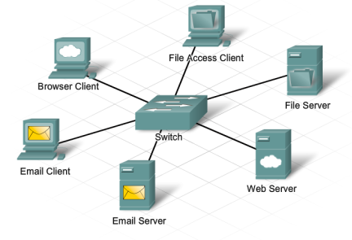
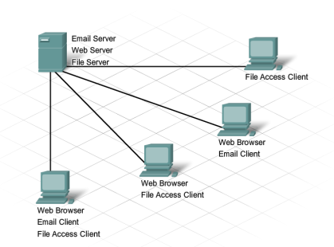
Providing Resources in a Network
Client-Server System
CCNA 1: 1.1.2.2 Clients and Servers
Notes:
CCNA 1: 1.1.2.2 Clients and Servers

Slide 14
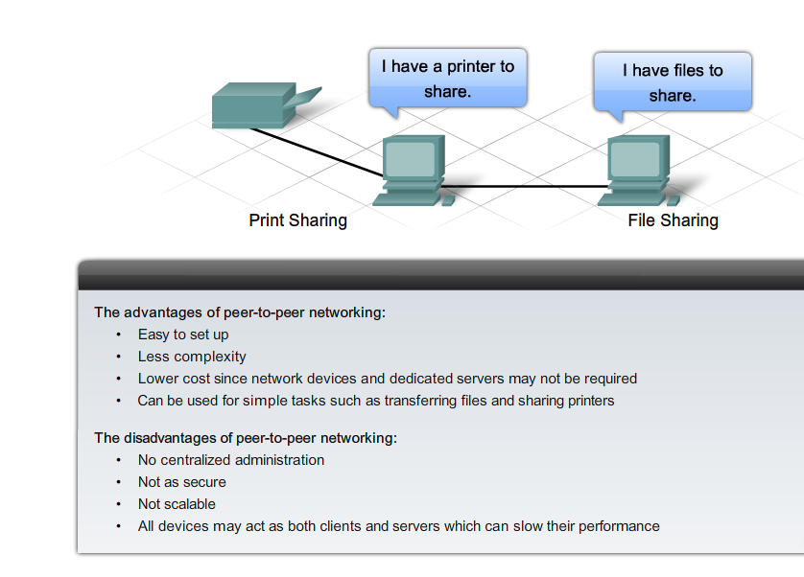
Providing Resources in a Network
Peer-to-Peer System
CCNA 1: 1.1.2.4 Peer-to-Peer
Notes:
CCNA 1: 1.1.2.4 Peer-to-Peer

Slide 15
Types of Connections
Point-to-point
A dedicated link between two devices
Multipoint (multidrop)
Devices share a single link

Slide 16


Point-To-Point Connection

Slide 17
Multipoint Connection
Wireless

Slide 18
Topology
Topology: physical arrangement of devices
Mesh
Star
Bus
Ring
Hybrid

Slide 19
Fully Connected Mesh Topology
Pros:
Dedicated links;
n(n-1)/2 links
Robustness
Privacy
Easy to identify fault
Cons:
A lot of cabling
I/O ports
Difficult to move
E
A
D
B
C

Slide 20
Star Topology
Pros:
One I/O port per device
Little cabling
Easy to install
Robustness
Easy to identify fault
Cons:
Single point of failure
More cabling still required
Hub

Slide 21
Bus Topology
Pros:
Little cabling
Easy to install
Cons:
Difficult to modify
Difficult to isolate fault
Break in the bus cable stops all transmission

Slide 22
Ring Topology
Pros:
Easy to install
Easy to identify fault
Cons:
Delay in large ring
Break in the ring stops
all transmission

Slide 23
Hybrid Topologies

Slide 24
Network Types
The two most common types of network infrastructures are:
Local Area Network (LAN)
Wide Area Network (WAN)
Other types of networks include:
Metropolitan Area Network (MAN)
Wireless LAN (WLAN)
Storage Area Network (SAN)
CCNA 1: 1.2.2.1 Types of Networks
Notes:
CCNA 1: 1.2.2.1 Types of Networks

Slide 25
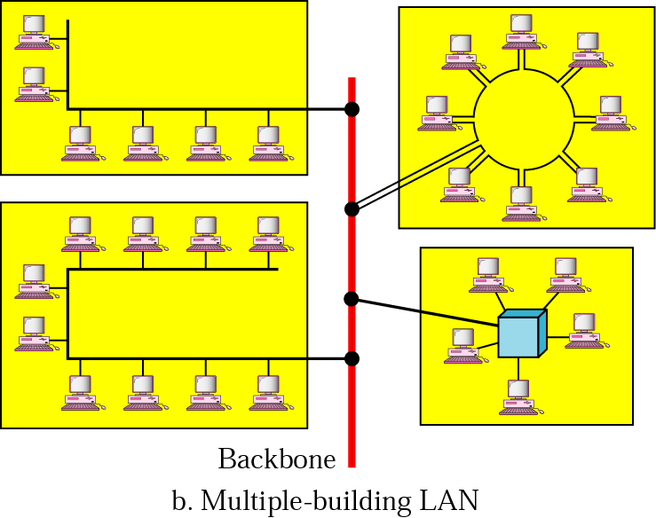
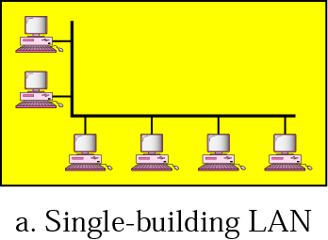
Local Area Networks
Network in a single office, building, or campus

Slide 26
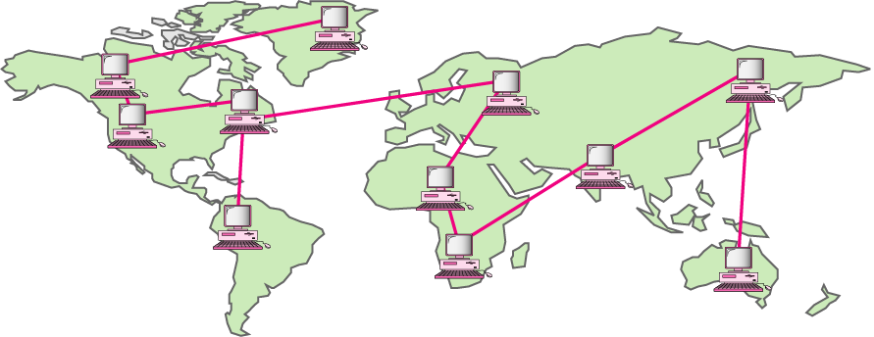
Wide Area Networks
Network providing long-distance communication over a country, a continent, or the whole world

Slide 27

Metropolitan Area Networks
Network extended over an entire city
Bangkhen
Kampangsaen

Slide 28

Circuit Switching
End-to-end resources reserved for “call”
Link bandwidth, switch capacity
Dedicated resources: no sharing
Circuit-like (guaranteed) performance
Call setup required
Re-establish call upon failure
Telephone switches establish circuits for communication
telephone switch

Slide 29

Packet Switching
Each end-to-end data stream (message) divided into packets
Each packet stamped with source and destination addresses
Routers know where to forward packets
Each packet uses full link bandwidth
Resources used as needed
Congestion: packets queue, wait for link use
Store and forward: packets move one hop at a time
Node receives complete packet before forwarding
Dedicated allocation
Resource reservation
Packet
Router

Slide 30




Packet Switching: Store and Forward
L bits
per packet
source
3
2
1
R bps
R bps
destination
takes L/R seconds to transmit (push out) L-bit packet into link at R bps
store and forward: entire packet must arrive at router before it can be transmitted on next link
end-end delay = 2L/R (assuming zero propagation delay)
one-hop numerical example:
L = 7.5 Mbits
R = 1.5 Mbps
one-hop transmission delay = 5 sec

Slide 31
Circuit Switching vs Packet Switching
Is packet switching a “slam dunk winner?”
great for bursty data
resource sharing (scalable!)
simpler, no call setup, more robust (re-routing)
excessive congestion: packet delay and loss
Without admission control: protocols needed for reliable data transfer, congestion control

Slide 32
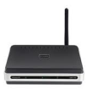

Internetworking
How to allow devices from different standards to communicate
Gateways/routers – devices capable of communicating in several standards
These become "network of networks"

Slide 33
Internetworks
Two or more networks connected become an internetwork, or internet
Example: The Internet
Network1
Network2
Gateway
Network3

Slide 34
The Internet
The largest internetwork (network of networks) in the world
The first packet switching network and predecessor to today’s Internet was the Advanced Research Projects Agency Network (ARPANET), which came to life in 1969 by connecting mainframe computers at four locations.
Stanford
U. of Utah
UC Santa Barbara
UCLA

Slide 35
Creation of Internet, Development of TCP/IP
ARPANET was funded by the U.S. Department of Defense for use by universities and research laboratories.
In 1973, Robert Kahn and Vinton Cerf began work on TCP to develop the next generation of the ARPANET. TCP was designed to replace ARPANET’s current Network Control Program (NCP).
In 1978, TCP was divided into two protocols: TCP and IP. Later, other protocols were added to the TCP/IP suite of protocols including Telnet, FTP, DNS, and many others.
Notes:
3.2.2.2 Creation of the Internet and Development of TCP/IP

Slide 36
Internet structure: network of networks
Question: given millions of access ISPs, how to connect them together?
…
…
access
net
access
net
access
net
access
net
access
net
access
net
access
net
…
…
access
net
access
net
access
net
access
net
access
net
access
net
…
access
net
access
net
…
access
net

Slide 37
Internet structure: network of networks
Option: connect each access ISP to every other access ISP?
…
…
access
net
access
net
access
net
access
net
access
net
…
…
access
net
access
net
…
connecting each access ISP to each other directly doesn’t scale: O(N²) connections.
…
…
access
net
access
net
…
access
net
access
net
access
net
…
access
net
…
access
net
access
net
…
access
net

Slide 38
Internet structure: network of networks
Option: connect each access ISP to a global transit ISP? Customer and provider ISPs have economic agreement.
…
…
access
net
access
net
access
net
access
net
access
net
access
net
access
net
…
…
global ISP
access
net
access
net
access
net
access
net
access
net
access
net
…
access
net
access
net
…
access
net

Slide 39
Internet structure: network of networks
But if one global ISP is viable business, there will be competitors ….
…
…
access
net
access
net
access
net
access
net
access
net
access
net
access
net
ISP A
…
…
access
net
ISP B
access
net
ISP C
access
net
access
net
access
net
access
net
…
access
net
access
net
…
access
net

Slide 40
Internet structure: network of networks
But if one global ISP is viable business, there will be competitors …. which must be interconnected
Internet exchange point
…
…
access
net
access
net
access
net
access
net
access
net
IXP
access
net
access
net
ISP A
…
…
IXP
access
net
access
net
ISP B
ISP C
access
net
access
net
peering link
access
net
access
net
…
access
net
access
net
…
access
net

Slide 41
Internet structure: network of networks
… and regional networks may arise to connect access nets to ISPS
…
…
access
net
access
net
access
net
access
net
access
net
IXP
access
net
access
net
ISP A
…
…
IXP
access
net
access
net
ISP B
ISP C
access
net
access
net
access
net
regional net
access
net
…
access
net
access
net
…
access
net

Slide 42
Internet structure: network of networks
… and content provider networks (e.g., Google, Microsoft, Akamai ) may run their own network, to bring services, content close to end users
…
…
access
net
access
net
access
net
access
net
access
net
IXP
access
net
access
net
ISP A
…
…
Content provider network
IXP
access
net
access
net
ISP B
ISP B
access
net
access
net
access
net
regional net
access
net
…
access
net
access
net
…
access
net

Slide 43
Internet structure: network of networks
Tier 1 ISP
Tier 1 ISP
Google
IXP
IXP
IXP
Regional ISP
Regional ISP
access
ISP
access
ISP
access
ISP
access
ISP
access
ISP
access
ISP
access
ISP
access
ISP
at center: small # of well-connected large networks
“tier-1” commercial ISPs (e.g., Level 3, Sprint, AT&T, NTT), national & international coverage
content provider network (e.g, Google): private network that connects it data centers to Internet, often bypassing tier-1, regional ISPs

Slide 44
“Real” Internet delays and routes
traceroute: rio.cl.cam.ac.uk to munnari.oz.au
(tracepath on pwf is similar)
Three delay measurements from
rio.cl.cam.ac.uk to gatwick.net.cl.cam.ac.uk
traceroute munnari.oz.au
traceroute to munnari.oz.au (202.29.151.3), 30 hops max, 60 byte packets
1 gatwick.net.cl.cam.ac.uk (128.232.32.2) 0.416 ms 0.384 ms 0.427 ms
2 cl-sby.route-nwest.net.cam.ac.uk (193.60.89.9) 0.393 ms 0.440 ms 0.494 ms
3 route-nwest.route-mill.net.cam.ac.uk (192.84.5.137) 0.407 ms 0.448 ms 0.501 ms
4 route-mill.route-enet.net.cam.ac.uk (192.84.5.94) 1.006 ms 1.091 ms 1.163 ms
5 xe-11-3-0.camb-rbr1.eastern.ja.net (146.97.130.1) 0.300 ms 0.313 ms 0.350 ms
6 ae24.lowdss-sbr1.ja.net (146.97.37.185) 2.679 ms 2.664 ms 2.712 ms
7 ae28.londhx-sbr1.ja.net (146.97.33.17) 5.955 ms 5.953 ms 5.901 ms
8 janet.mx1.lon.uk.geant.net (62.40.124.197) 6.059 ms 6.066 ms 6.052 ms
9 ae0.mx1.par.fr.geant.net (62.40.98.77) 11.742 ms 11.779 ms 11.724 ms
10 ae1.mx1.mad.es.geant.net (62.40.98.64) 27.751 ms 27.734 ms 27.704 ms
11 mb-so-02-v4.bb.tein3.net (202.179.249.117) 138.296 ms 138.314 ms 138.282 ms
12 sg-so-04-v4.bb.tein3.net (202.179.249.53) 196.303 ms 196.293 ms 196.264 ms
13 th-pr-v4.bb.tein3.net (202.179.249.66) 225.153 ms 225.178 ms 225.196 ms
14 pyt-thairen-to-02-bdr-pyt.uni.net.th (202.29.12.10) 225.163 ms 223.343 ms 223.363 ms
15 202.28.227.126 (202.28.227.126) 241.038 ms 240.941 ms 240.834 ms
16 202.28.221.46 (202.28.221.46) 287.252 ms 287.306 ms 287.282 ms
17 * * *
18 * * *
19 * * *
20 coe-gw.psu.ac.th (202.29.149.70) 241.681 ms 241.715 ms 241.680 ms
21 munnari.OZ.AU (202.29.151.3) 241.610 ms 241.636 ms 241.537 ms
trans-continent
link
* means no response (probe lost, router not replying)
Notes:
Where did the delay come from??

